Slide 1
Microservices Fundamentals

Slide 2
Contents
How did we get here
What’s in a name
What is a Microservice Architecture
What is a Microservice
Benefits of Microservices
Downsides of Microservices
Use Cases for Microservices

Slide 3
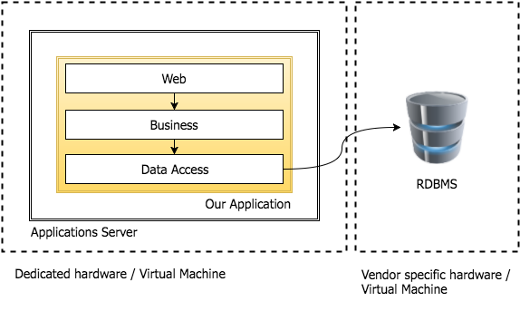
How did we get here
The Monolith

Slide 4

How did we get here (cont)
Lets list some Pros for this architecture
What was easy
Why did we do it this way?

Slide 5
How did we get here (cont)
Lets list some Pros for this architecture
Single Deployable Artifact
Transactions are simple
In process calls between tiers
…

Slide 6
How did we get here (cont)
Now Lets list some Cons for this architecture
What was difficult?
Why did we change from this architecture?

Slide 7
How did we get here (cont)
Now Lets list some Cons for this architecture
Scaling is expensive
Changing one components means redeploying all of them
Large testing surface
…

Slide 8
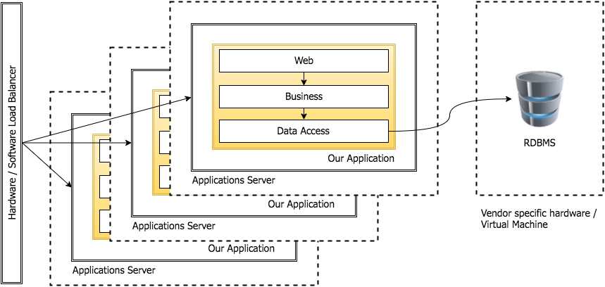
How did we get here (cont)
Scaling the Monolith

Slide 9
How did we get here (cont)
Scaling the Monolith – Pros & Cons

Slide 10
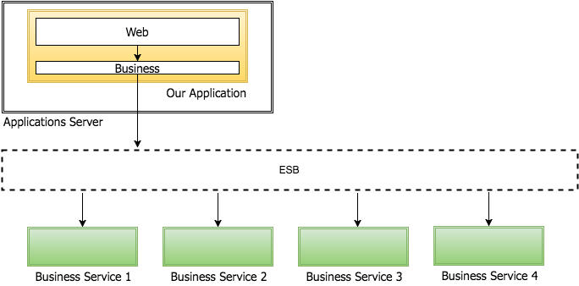
How did we get here (cont)
Service Oriented Architecture

Slide 11
How did we get here (cont)
Lets list some Pros for this architecture
What was easy
Why did we do it this way?

Slide 12
How did we get here (cont)
Lets list some Pros for this architecture
Smaller deployable artifacts
Standardized communication between processes
Simpler to integrate legacy systems
…

Slide 13
How did we get here (cont)
Now Lets list some Cons for this architecture
What was difficult?
Why did we change from this architecture?

Slide 14
How did we get here (cont)
Now Lets list some Cons for this architecture
Scaling is still difficult
SOAP Web Services communications are heavyweight
Complex infrastructure
…

Slide 15
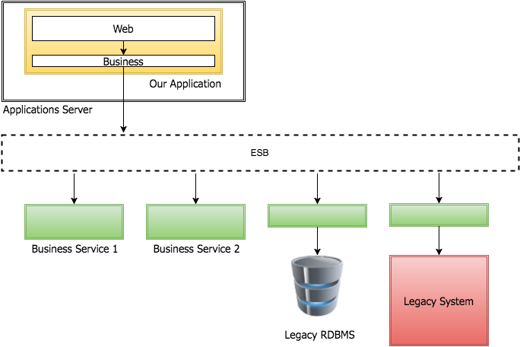
How did we get here (cont)
Service Oriented Architecture – Legacy Integration

Slide 16
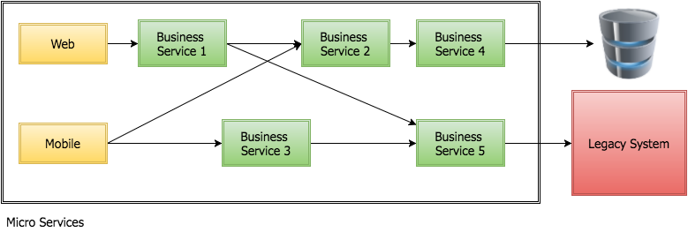
How did we get here (cont)
Microservices

Slide 17
What’s in a name?
Micro-service
Microservice
What’s the difference?
Is a Microservice a micro-service?

Slide 18
What is a Microservice Architecture?
Adrian Cockcroft formerly of Netflix defines a microservices architecture as
The concept of bounded contexts comes from the book Domain Driven Design by Eric Evans
‘A service-oriented architecture composed of loosely coupled elements that have bounded contexts.’

Slide 19
What is a Microservice Architecture? (cont)
Loosely Coupled
Out of process communication
Well defined interfaces
Discreet responsibilities
Bounded Context
Limit the context of a component
Limited Responsibility
Other features
No heavyweight SOAP
No ESB

Slide 20
What is a Microservice?
A discreet application component
Focussed on a single (or minimal) business domain
Part of a larger application
Independently…
Deployable
Testable
Scalable
Lightweight
Quick to…
Start
Stop
Replace

Slide 21
Benefits of Microservices
What benefits can you think of with a microservices architecture?

Slide 22
Benefits of Microservices (cont)
What benefits can you think of with a microservices architecture?
Individually scalable components
Deploy only what’s changed
Simpler test surface

Slide 23
Downsides of Microservices
What problems can you think of with a microservices architecture?

Slide 24
Downsides of Microservices (cont)
What problems can you think of with a microservices architecture?
How micro is right?
Manage multiple databases
Managing downstream failures
Transactions?
Increased infrastructure complexity
Testing, scaling, monitoring
Service discovery

Slide 25
Use Cases for Microservices?
Many new projects are now favouring Microsevices
Existing projects could transition
Reducing Complexity
Breaking the monolith

Slide 26
Recap…
How did we get here
What’s in a name
What is a Microservice Architecture
What is a Microservice
Benefits of Microservices
Downsides of Microservices
Use Cases for Microservices

Slide 27
Any Questions?

